Slide 1

Does Going Green Save you green?
By Daniel Valencia
Bethel Tech, data science

Slide 2
My Background
Graduated HS and worked at Olive Garden
Jobs with family from Cali to Montana
Moved from Montana to California
Worked at concrete manufacturer
Enrolled in Bethel Tech (data science)
2008
2019
2020/21
2014
2020

Slide 3
Project intro
The times we live in
To go green or not
Is it worth it?

Slide 4
Project background info
Electricity
Things to be measured
Cost of vehicles
Cost of gas and electricity
Miles per Gallon/per charge
Cost of maintenance/repairs
Is it really worth it? (What is valuable to you)
kWh – a measure of how much energy you are using
The kilowatt-hour is commonly used as a billing unit for energy delivered to consumers by electric utilities.
How electric vehicles measure their battery capacity

Slide 5

Data sources
Kaggle.com
U.S. Energy Information Administration
Greencarreports.com
The Federal Highway Administration
ConsumerReports.org
Kbb.com (Kelley blue books)
Craigslist.org

Slide 6
Data Methods
Finding Data Sources
The sample Size
The Cleaning
The combining
The Manipulation
The summary

Slide 7
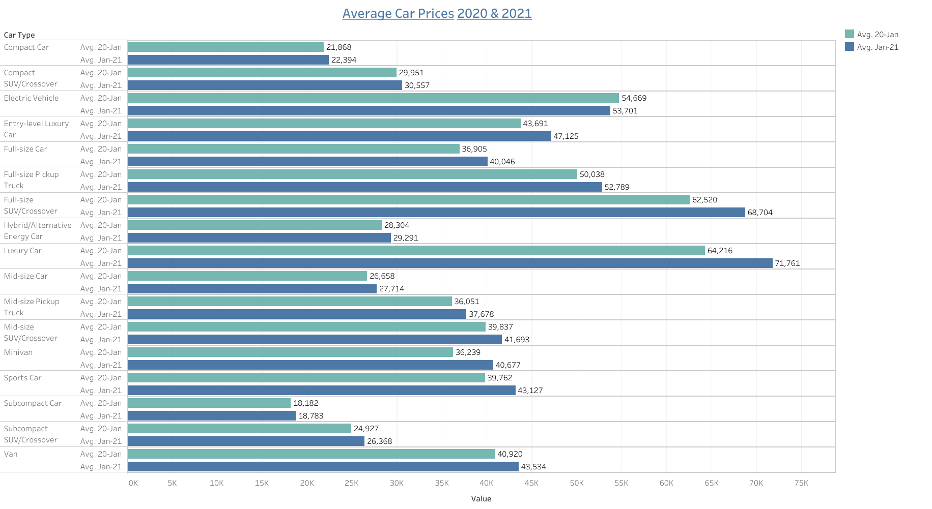

Slide 8
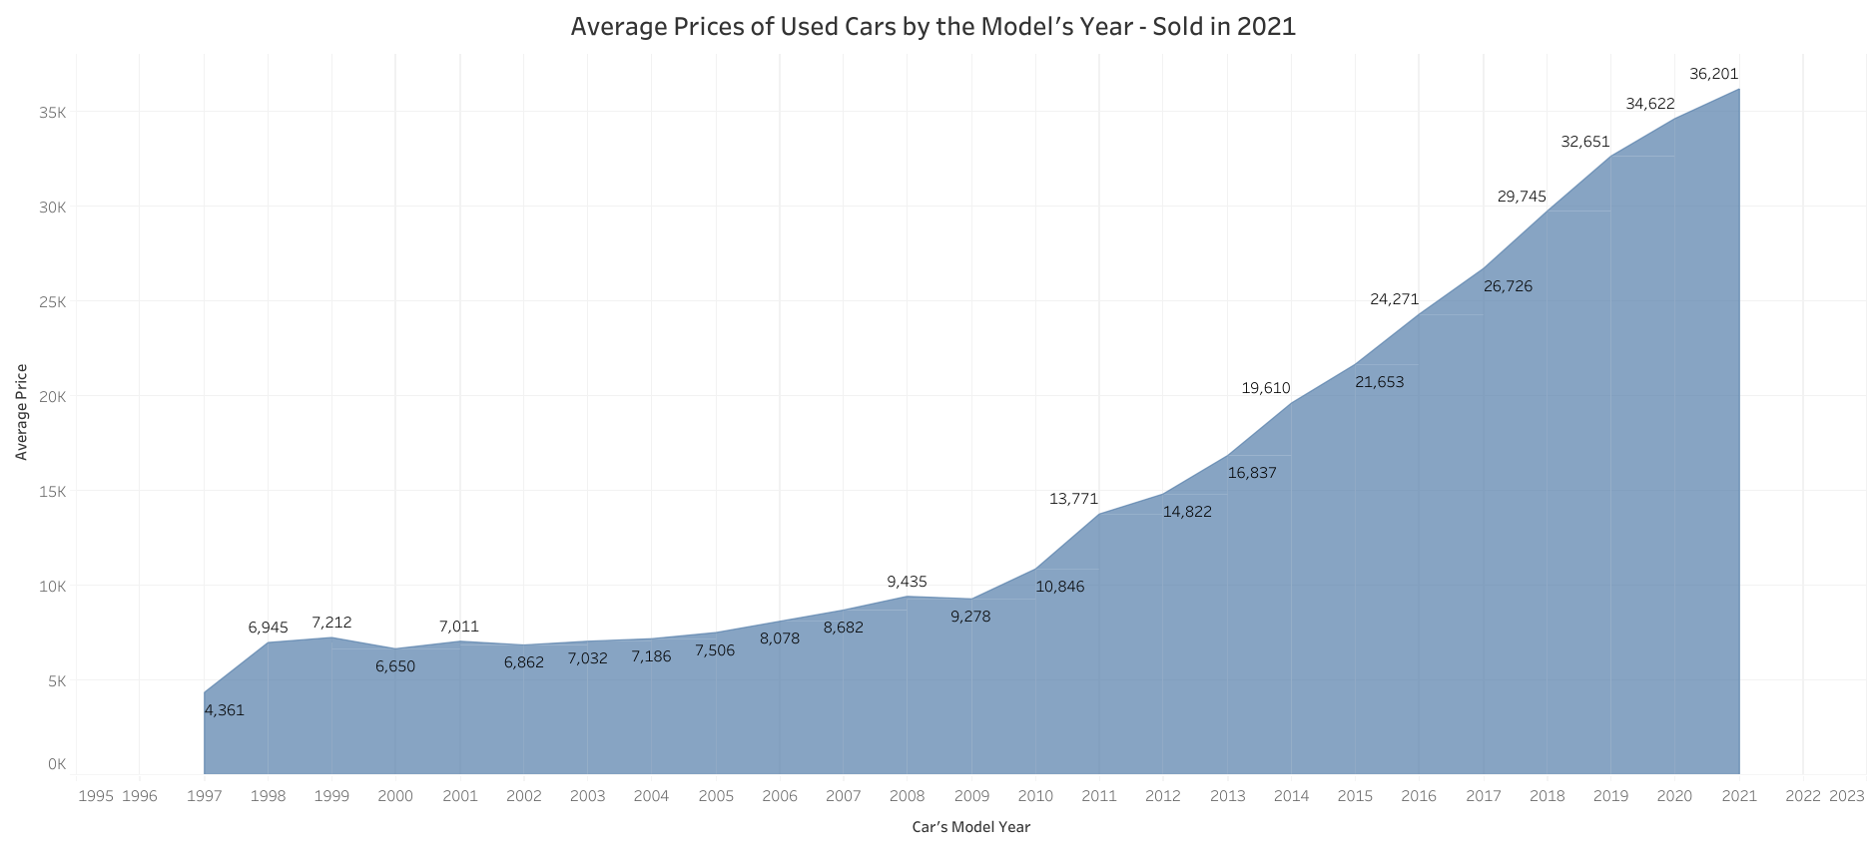

Slide 9
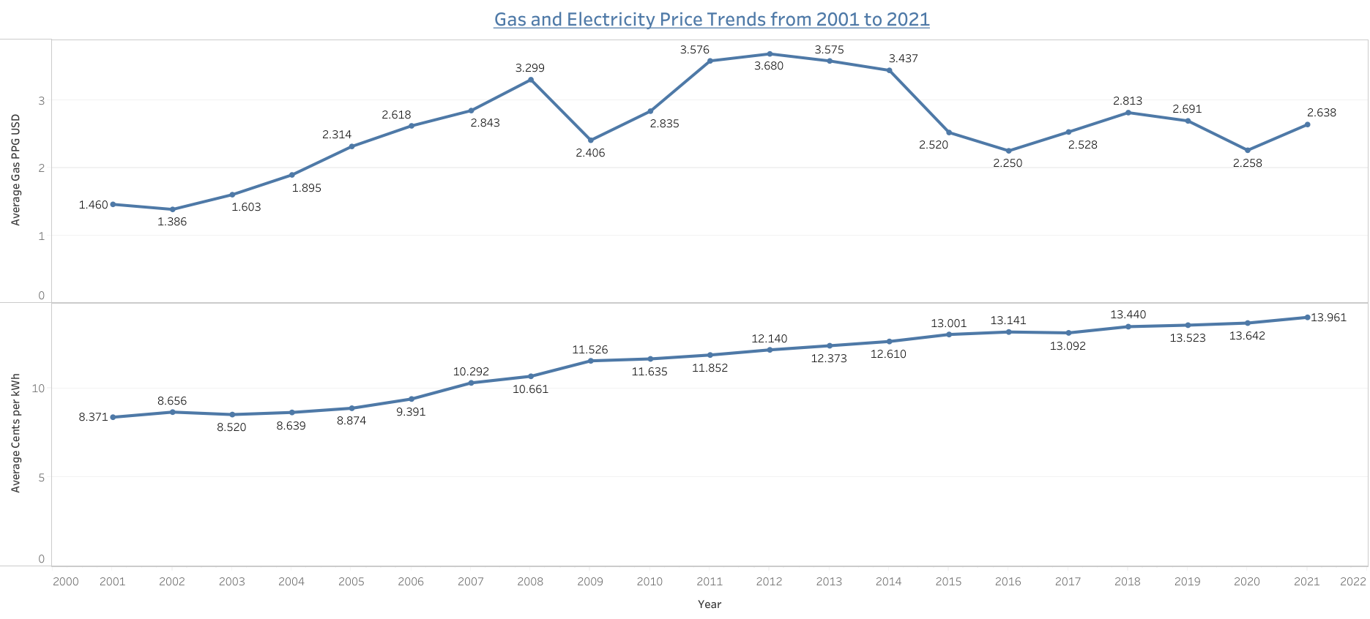

Slide 10
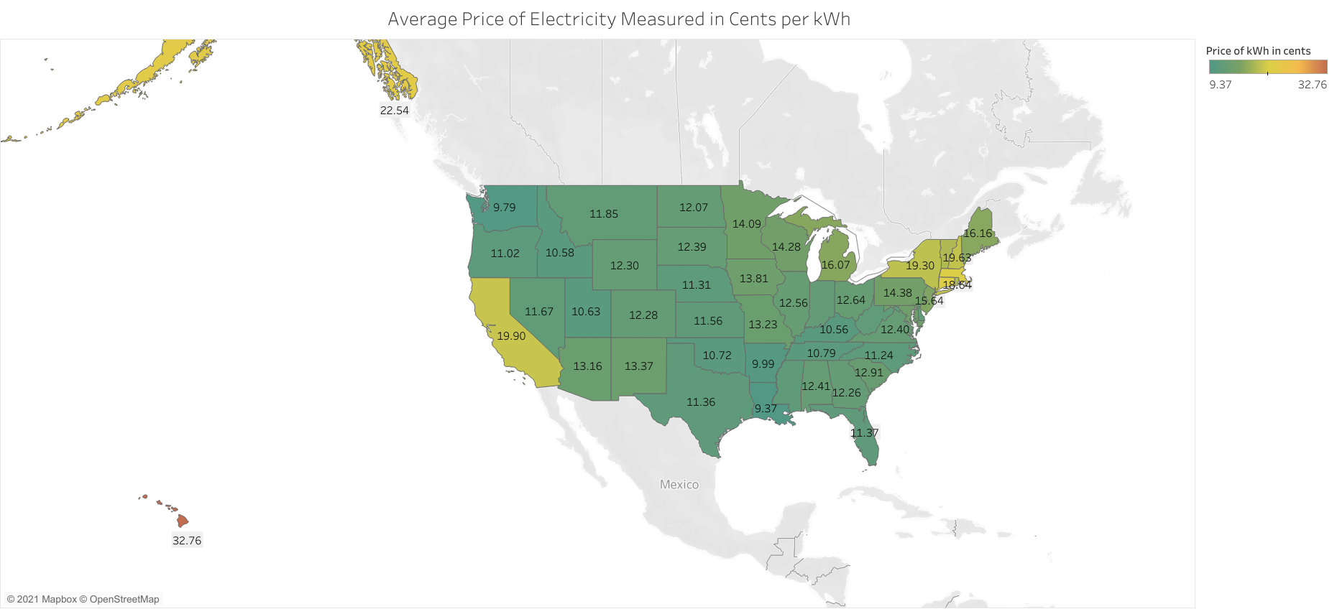

Slide 11
Gas vs electricity savings The average person drives on Average 13,500 miles per year – according to the 2019 study by the Federal Highway Administration
Gasoline Vehicle
Electric Vehicle
Avg MPG = 25
Avg Cost of Gas for me = $4.00
13,500mi / 25mpg = 540 gallons of gas
540gallons X $4.00 = $2,160 per year
Avg miles per charge = Depends on battery size
40 kWh battery = 168 miles (Nissan Leaf)
100 kWh battery = 388 miles (Tesla Model S 100D)
Avg miles per kWh = 3.6
13,500 / 3.6 = 3,750 kWh
Avg cost of kWh for me is 19.9 cents
19.9 cents X 3,750 kWh = $746.25 per year
Savings of $1,413.75 in gas costs per year

Slide 12
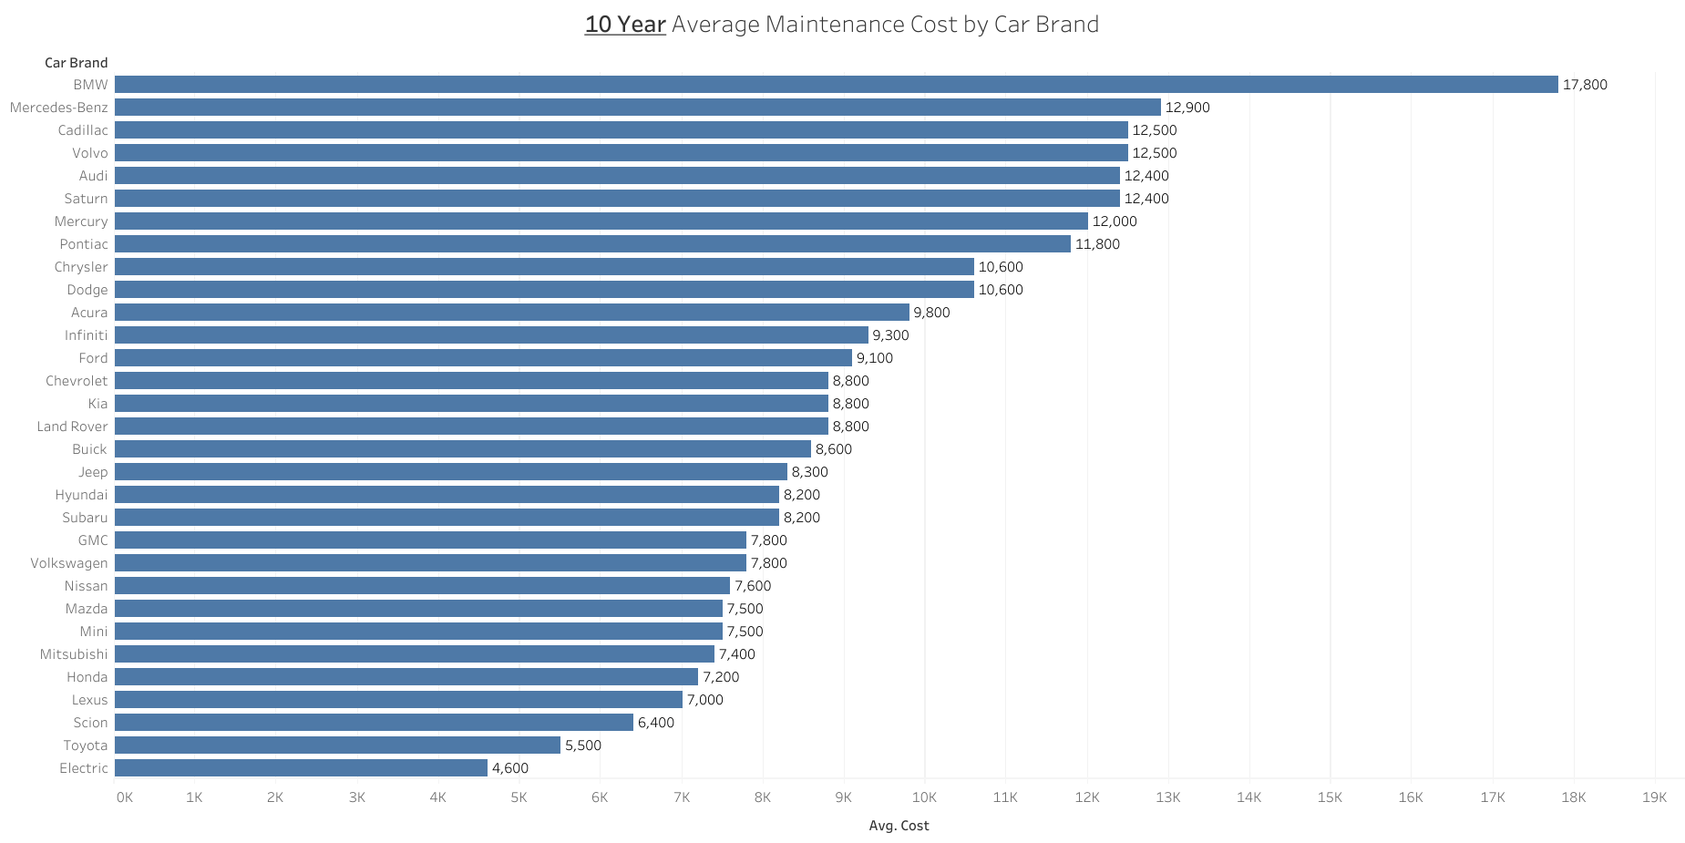

Slide 13
Maintenance Savings
Regular Vehicle
Electric Vehicle
10-year maintenance costs for a Ford = $9,100
10-year maintenance costs for an electric vehicle = $4,600
$9,100 - $4,600 = $4,500 savings in 10 years

Slide 14
Vehicle Cost
Regular Vehicle
Electric Vehicle
Average Full Size Pickup Truck Price = $52,789
2019 Ford Flex = $30,000 - $40,000
2019 Honda Civic = $19,550 - $27,400
2019 BMW X6 = $63,550 - $78,300
Average Electric Vehicle = $53,701
2019 Nissan Leaf w/40kWh Battery = $31,670
2019 Tesla Model S 100D w/100kWh battery = $75,000 to $99,990

Slide 15
Total cost comparison (Small Vehicle)
2019 Honda Civic
2019 Nissan Leaf
Price = $19,550
MPG = 37 -- Distance on one tank of gas = 458 miles
10-year driving cost for gas @ $4 a gallon with 13,500 miles a year = $14,594.40
10-year maintenance cost = $7,200
Total Cost after 10 Years = $41.344.40
Price = $31,670
Distance on 40kWh battery = 168 miles
10-year driving cost for electricity @ 19.9cents per kWh = $6,396.43
10-year maintenance cost = $4,600
Total Cost after 10 Years = $42,666.43
Total Savings after 10 Years = - $1,322.03

Slide 16
Total cost comparison (Larger Vehicle)
2019 BMW X6
2019 Tesla Model S 100D
Price = $70,000
MPG = 21 -- Distance on one tank of gas = 470.4 miles
10-year driving cost for gas @ $4 a gallon with 13,500 miles a year = $25,714.20
10-year maintenance cost = $17,800
Total Cost after 10 Years = $113,514.20
Price = $85,000
Distance on 100kWh battery = 388 miles
10-year driving cost for electricity @ 19.9cents per kWh = $6,923.97
10-year maintenance cost = $4,600
Total Cost after 10 Years = $96,523.97
Total Savings after 10 Years = $16,990.23

Slide 17
So, it really worth it to buy an electric vehicle?
It depends….
Electric vehicles are more expensive than most average vehicles
Electric mileage costs are much lower than gas costs
Electric vehicle maintenance costs are the lowest among all vehicles
However…..
Electric vehicles are limited in their abilities
What is important to you? Free roaming ability?
How much are you willing to spend on a vehicle?
Fun Fact: An extra 100 kWh battery for a Tesla costs about $15,000 @ $150 per 1 kWh
Do you need to have a “New” car?
Are you willing to get a used car?

Slide 18

Conclusions
Answered the question about going green
What is is valuable to you
It’s not as simple to just say go green to save money

Slide 19

Questions?

